Slide 1
Volcanic perturbations
By: Chris Lawler

Slide 2
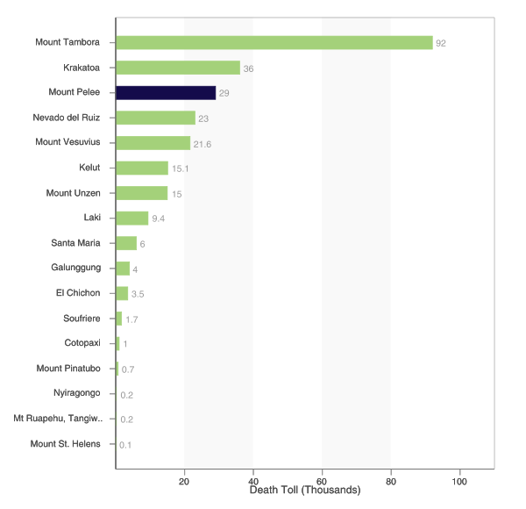
Why do we care?

Slide 3
Why small explosive eruptions?
More frequent and periodic for decades
Can mark waxing or waning phases of larger eruptions
Similar dynamics of larger eruptions
They an react with the atmosphere in unique ways.

Slide 4
Goals of research
Discover more about volcanic perturbations and how they react with the atmosphere
Find a relationship between eruption size and atmospheric perturbations using small volcanic eruptions. The relationship might work for large volcanic eruptions also.
Find whether or not volcanic perturbations can be used to better understand volcanic eruptions.

Slide 5
Experiment
A large tank was filled with water
Highly pressured water was injected into the tank to cause disturbance at the surface.
A high speed camera was set up to view everything that was happening.

Slide 6
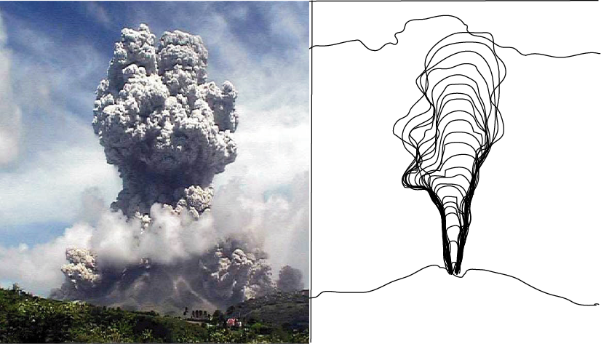
Schematic

Slide 7
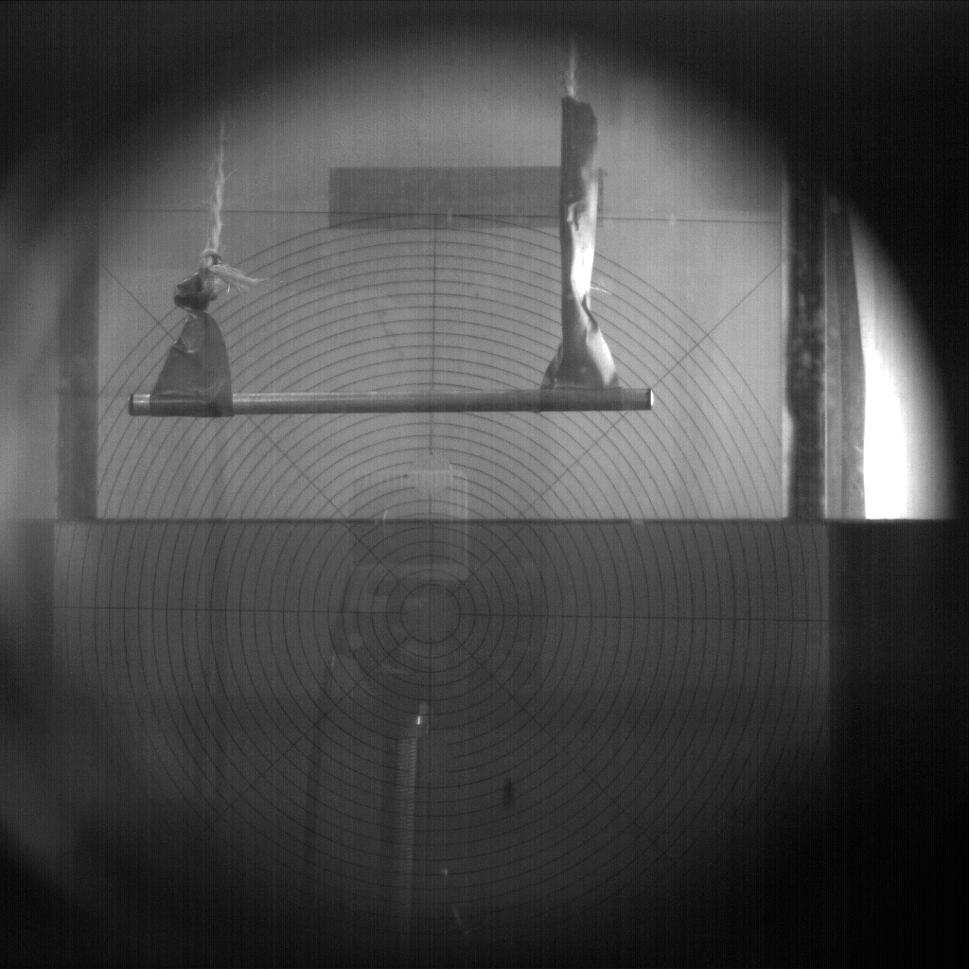
Video

Slide 8
Graph

